Slide 1








PROMOGEN

Slide 2

MEMBERS
01
RUSHIKESH
BAGUL
30
ASHWIN MAHAWAR
36
BISWAJIT PANDA
61
BHAVIN
WAGHELA

Slide 3


Creating effective promotional scripts requires time, creativity, and an understanding of audience psychology. Traditional methods are slow and may lack the agility needed in today’s fast-paced digital environment.
PROBLEM
PromoGen uses AI to automate promotion script generation, providing customized, high-quality content based on target audience, tone, and messaging. It simplifies the creative process, enabling rapid script creation for diverse platforms, saving time and enhancing productivity.
STATEMENT

Slide 4
01
LITERATURE
SURVEY
LARGE LANGUAGE MODEL FOR CREATIVE WRITING AND ARTICLE GENERATION
ABSTRACT
The implementation of large language models for text production tasks is highlighted throughout this study, including advancements in model topologies, pre-training techniques, controllability, and fine-tuning tactics. They set the stage for further study and advancement in the area of natural language production by showcasing the adaptability and efficiency of LLMs in producing excellent content for a variety of applications.

Slide 5
02
LITERATURE
SURVEY
FINE-TUNING THE GEMMA MODEL FOR KAGGLE ASSISTANT
ABSTRACT
This study explores the fine-tuning of Google’s open-source Gemma model using Low-Rank Adaptation (LoRA) to develop a Kaggle assistant. The fine-tuning achieved a sparse categorical cross-entropy loss of 0.4943 and a precision of 0.7753. LoRA improves the model’s interpretability and performance, offering accurate recommendations for Kaggle problem-solving. Experiments revealed possible overbuilding after 10 epochs, but the model showed solid results within this range. LoRA fine-tuning enhances the AI assistant's value for data scientists on Kaggle, optimizing their workflow and user experience.

Slide 6

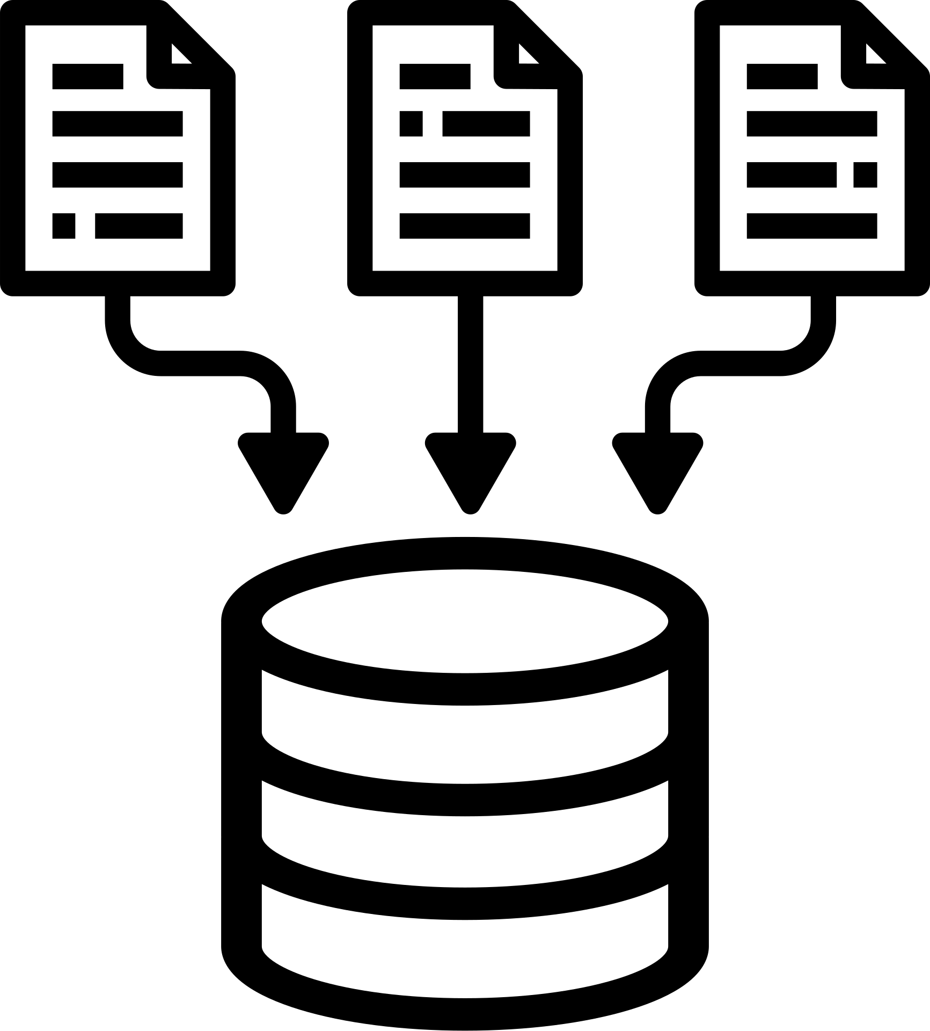




WORKFLOW
DATA COLLECTION
EVALUATION & ITERATION
DISPLAY
IF NOT APPROVED
1
3
5
2
4
IF APPROVED
SCRIPT GENERATION
SCRIPT APPROVAL

Slide 7
01
ALGORITHMS USED
Gemma a Google's open-source LLM, enhancing generative tasks through advanced techniques like Low-Rank Adaptation.
02
T5 transforms all NLP tasks into text-to-text formats, enabling flexibility across diverse applications.
03
LLaMA is Meta’s efficient foundational language model family, promoting research in generative AI.

Slide 8

PROJECT STATUS
PROMOGEN
DATA COLLECTION AND PRE-PROCESSING
ADVERTISEMENT SCRIPT GENERATION
CHECK IF SCRIPT GENERATION IS SUCCESSFUL
DISPLAY GENERATED SCRIPT

Slide 9
01
REFERENCES
https://www.researchgate.net/publication/380262942_Large_Language_Model_for_Creative_Writing_and_Article_Generation
02
https://www.researchgate.net/publication/380262942_Large_Language_Model_for_Creative_Writing_and_Article_Generation

Slide 10
THANK YOU
FOR ATTENTION

